Slide 1
ETL & ELT Techniques
Describe what an ETL process is
Explain what data loading means
Describe why ELT is an emergent trend
Describe the trending shift from ETL to ELT
Summarize data extraction techniques
Name data transformation techniques
List ways information can be “lost in transformation”
Summarize data loading techniques
Differentiate batch loading from stream loading ​
Contrast ETL and ELT.

Slide 2
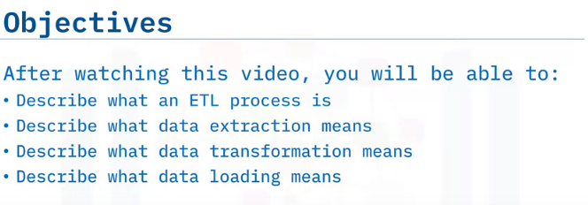
ETL Fundamentals

Slide 3
ETL stands for Extract, Transform, and Load.
ETL is an automated data pipeline engineering methodology, whereby data is acquired and prepared for subsequent use in an analytics environment, such as a data warehouse or data mart.
ETL refers to the process of curating data from multiple sources, conforming it to a unified data format or structure, and then loading the transformed data into its new environment.
The Extraction process obtains or reads the data from one or more sources.
The Transformation process wrangles the data into a format that is suitable for its destination and its intended use.
The final Loading process takes the transformed data and loads it into its new environment, ready for visualization, exploration, further transformation, and modelling.
The curated data may also be utilized to support automation and decision-making.
What is Extraction?
To extract data is to configure access to it and read it into an application. Normally this is an automated process.
Some common methods include:
Web scraping, where data is extracted from web pages using applications such as Python or R to parse the underlying HTML code, and Using APIs to programmatically connect to data and query it.
The source data may be relatively static, such as a data archive, in which case the extraction step would be a stage within a batch process.
On the other hand, the data could be streaming live, and from many locations.
Examples include weather station data, social networking feeds, and IoT devices.

Slide 4
What is data transformation?
Data transformation, also known as data wrangling, means processing data to make it conform to the requirements of both the target system and the intended use case for the curated data.
Transformation can include any of the following kinds of processes:
Cleaning: fixing errors or missing values.
Filtering: selecting only what is needed.
Joining disparate data sources: merging related data.
Feature engineering: such as creating KPIs for dashboards or machine learning.
Formatting and data typing: making the data compatible with its destination.
What is data loading?
Generally this just means writing data to some new destination environment.
Typical destinations include databases, data warehouses, and data marts.
The key goal of data loading is to make the data readily available for ingestion by analytics applications so that end users can gain value from it.
Applications include dashboards, reports, and advanced analytics such as forecasting and classification.

Slide 5
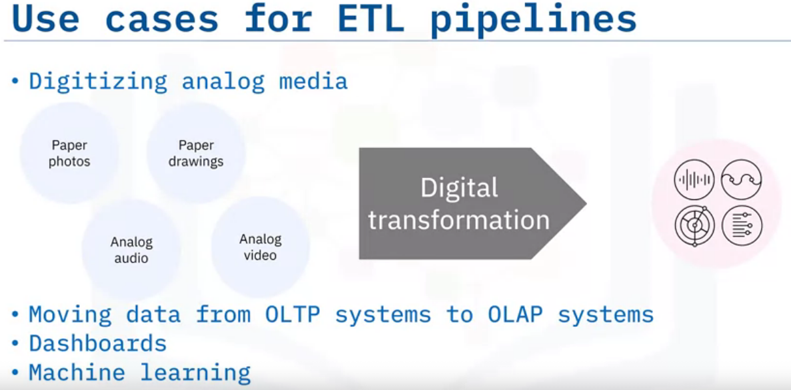
There are many use cases for ETL pipelines.
A very large amount of information is either already recorded or being generated, but is not yet captured, or accessible, as a digital file.
Examples include paper documents, photos and illustrations, and analog audio and video tapes.
Digitizing analog data includes extraction by some form of scanning, analog-to-digital transformation, and, finally, storage into a repository.
Online transaction processing (OLTP) systems don’t save historical data.
Accordingly, ETL processes capture the transaction history and prepare it for subsequent analysis in an online analytical processing (OLAP) system.
Other use cases include engineering ‘features’, or KPIs, from data sources, as preparation for:
Ingestion by dashboards used by operations, sales and marketing, customers, and executives.
Training and deploying machine learning models for prediction and augmented decision making.

Slide 6
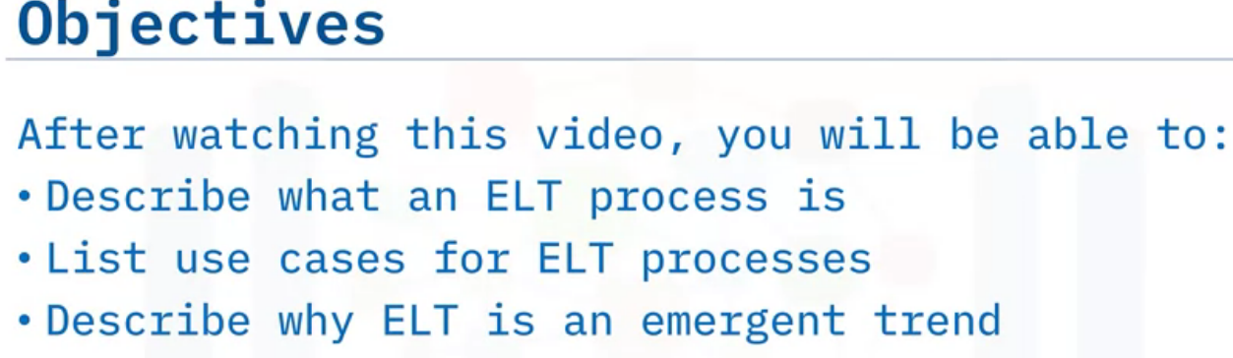
ELT Basics

Slide 7
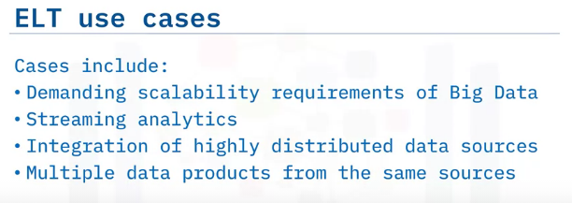
ELT stands for: Extract, ​ Load, and ​ Transform.​
ELT is an acronym for a specific automated data pipeline engineering methodology.​
ELT is similar to ETL in that similar stages are involved but the order in which they are performed is different.
ELT
For ELT processes, data is acquired and directly loaded, as-is, into its destination environment.
From its new home, usually a sophisticated analytics platform such as a data lake, it can be transformed on demand and however users wish. ​
Like ETL, the first stage in the ELT process is Extraction. The Extraction process obtains the data from all sources and reads the data, often in an asynchronous fashion, into an application.​
The Loading process takes the raw data as-is , and loads it into its new environment, where modern analytics tools can then be used directly.
The Transformation process for ELT is much more dynamic than it is for conventional ETL.
Modern analytics tools in the destination environment enable interactive, on-demand exploration and visualization of your data, including advanced analytics such as modelling and prediction.

Slide 8
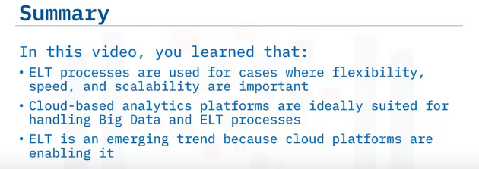
Why is ELT emerging?
cloud computing solutions are evolving at tremendous rates due to the demands of Big Data.
They can easily handle huge amounts of asynchronous data which can be highly distributed around the world.
Cloud computing resources are practically unlimited, and they can scale on demand.
Unlike traditional on-premises hardware, you only pay for the computing resources you use.
You don’t have to worry about underutilizing resources, that is, overspending on equipment.
With ELT, you have a clean separation between moving data and processing data.
cloud computing is equally prepared to handle the most challenging cases for either of these two tasks.
There may be many reasons to transform your data and just as many ways to do it.
Thus, ELT is a flexible option that enables a variety of applications from the same source of data.
Because you are working with a replica of the source data, there is no information loss.
Many kinds of transformations can lead to information loss, and if these happen somewhere upstream in the pipeline, it may be a long time before you can have a change request met.
Worse yet, the information may be forever lost if the raw data is not stored.

Slide 9
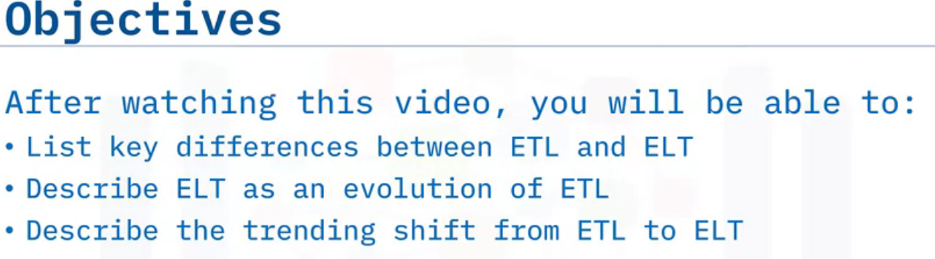
ETL vs ELT comparison

Slide 10
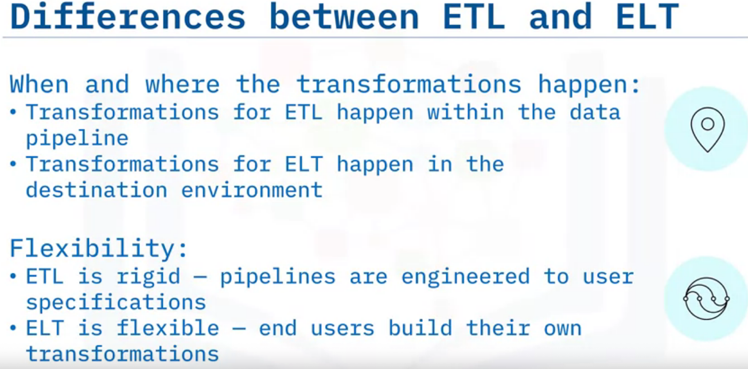
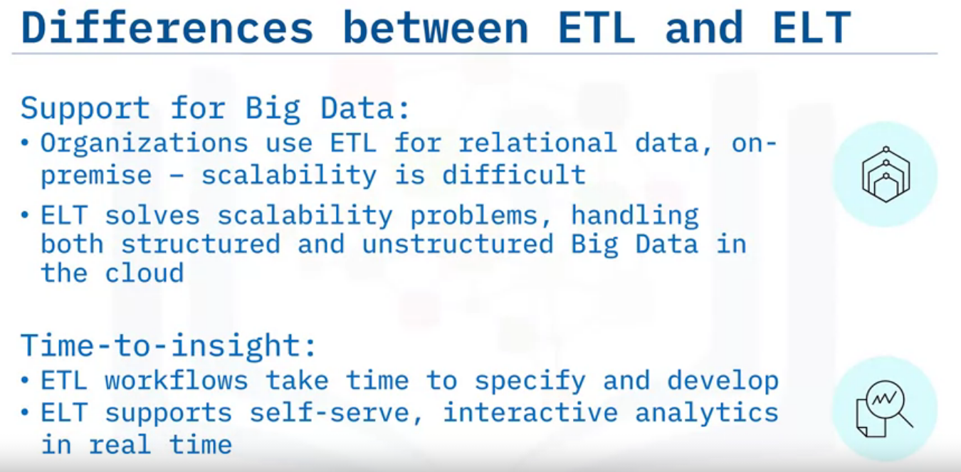

Slide 11
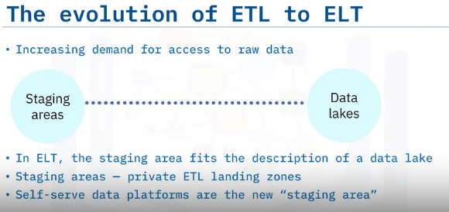
ELT is a natural evolution of ETL.
One of the factors driving that evolution is the demand to release raw data to a wider user base for the enterprise.
Traditionally, ETL processes include an intermediate storage facility called a staging area.
This is a holding area for raw extracted data, where you can run processes prior to loading the resulting transformed data into a data warehouse or a data mart.
This sounds a lot like an ELT process, and the staging area fits the description of a data lake, which is a modern self-serve repository for storing and manipulating raw data.
A traditional staging area, however, is not something that is usually shared across the company.
It's a private, siloed area set aside for developing, monitoring, and performance tuning the data pipeline and its built-in transformations.
Along with the ever-increasing ease-of-use and connection capabilities of analytics tools, raw data sources have become much more accessible to less technical end users. Accordingly, the paradigm is shifting to self-service data platforms.

Slide 12
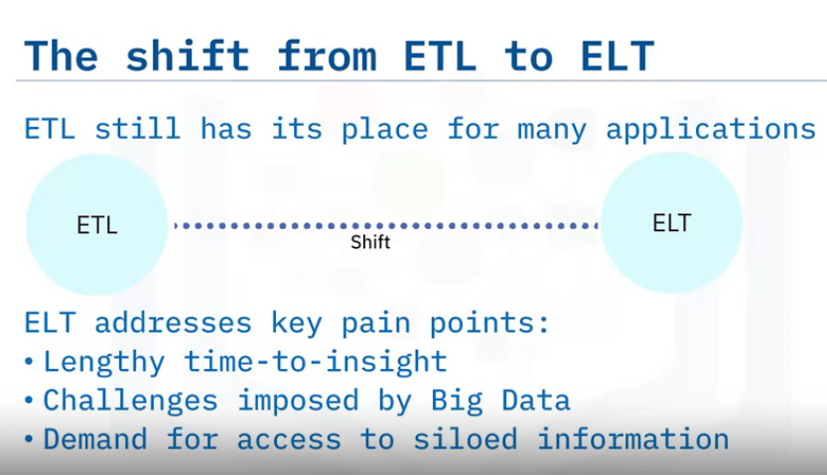

Slide 13
Data Extraction Techniques

Slide 14
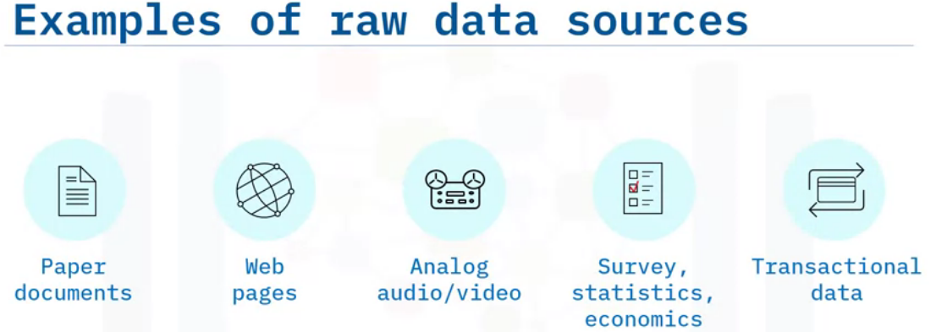
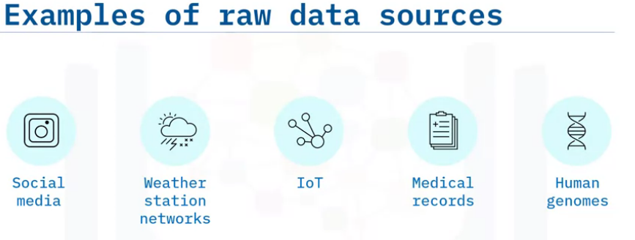
DNA/RNA

Slide 15
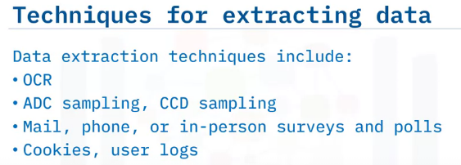
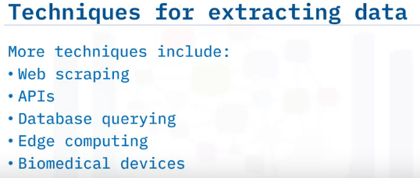
There are many techniques for extracting data,
depending on the kind of data source and the intended use of the data. Examples include:
Optical character recognition (OCR), which is used to interpret and digitize text scanned from paper documents so it can be stored as a computer-readable file
Analog-to-digital converters (ADCs), which can digitize analog audio recordings and signals, and charge-coupled devices (CCDs) that capture and digitize images Opinions, questionnaires, and
vital statistical data obtained through polling and census methods
Cookies, user logs, and other methods used for tracking human or system behavior
More techniques include:
Web scraping, used to crawl web pages in search of text, images, tables, and hyperlinks.
APIs, which are readily available for extracting data from all sorts of online data repositories and feeds, such as government bureaus of statistics, libraries, weather networks, online shopping, and social networks.
SQL languages for querying relational databases, and NoSQL for querying document, key-value, graph or other non-structured data repositories.
Edge computing devices, such as video cameras that have built-in processing that can extract features from raw data
devices, such as microfluidic arrays that can extract DNA sequences

Slide 16
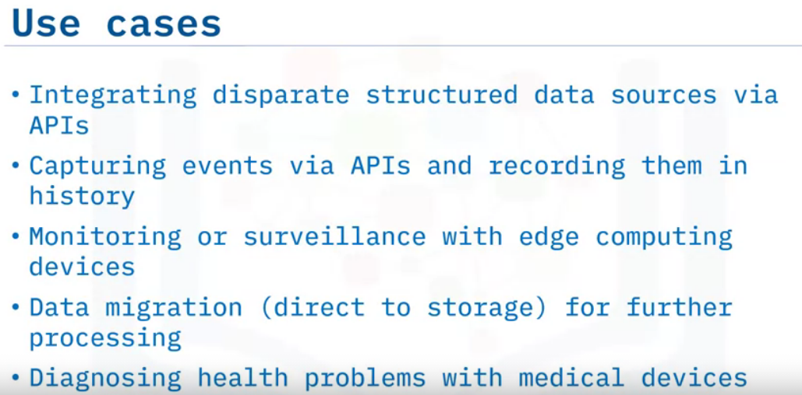
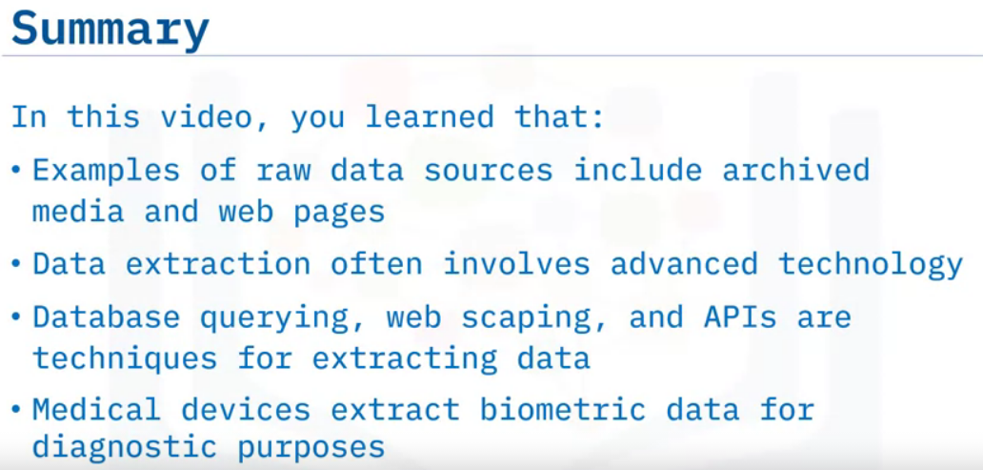

Slide 17
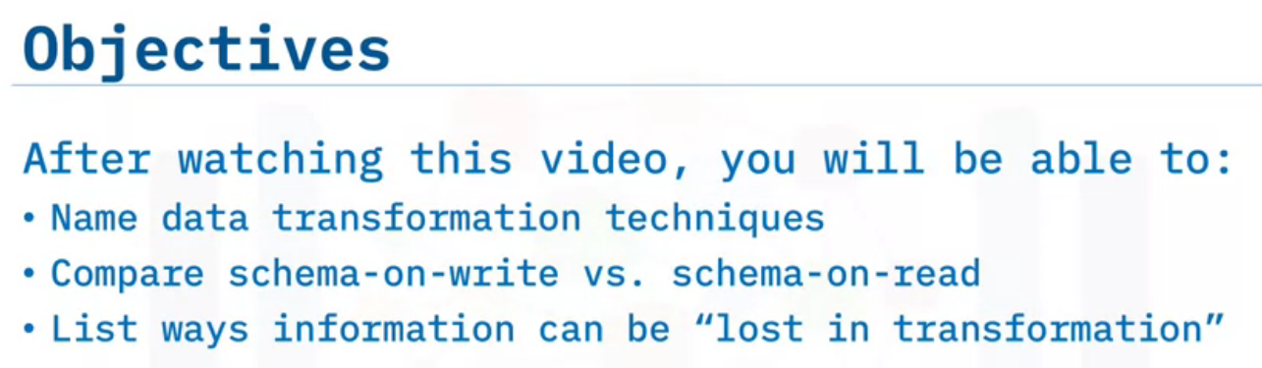
Introduction to Data Transformation Techniques

Slide 18
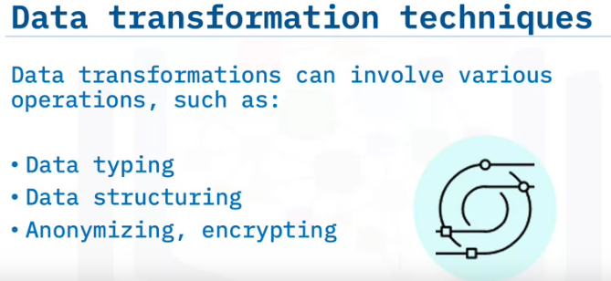
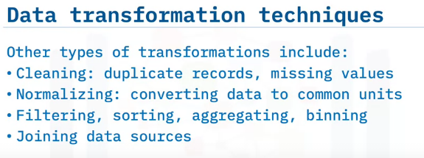
Data transformation is mainly about formatting the data to suit the application.
This can involve many kinds of operations, such as:
Data typing, which involves casting data to appropriate types, such as integer, float, string, object, and category.
Data structuring, which includes converting one data format to another, such as JSON, XML, or CSV to database tables.
Anonymizing and encrypting transformations to help ensure privacy and security
Other types of transformations include:
Cleaning operations for removing duplicate records and filling missing values.
Normalizing data to ensure units are comparable, for example, using a common currency.
Filtering, sorting, aggregating, and binning operations for accessing the right data at a suitable level of detail and in a sensible order.
Joining, or merging, disparate data sources.

Slide 19
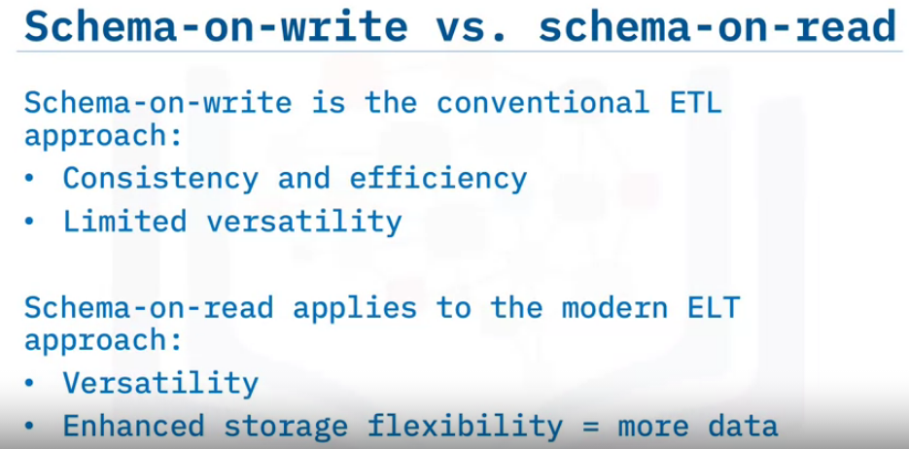
Schema-on-write is the conventional approach used in ETL pipelines, where the data must be conformed to a defined schema prior to loading to a destination, such as a relational database.
The idea is to have the data consistently structured for stability and for making subsequent queries much faster, but this comes at the cost of limiting the versatility of the data.
Schema-on-read relates to the modern ELT approach, where the schema is applied to the raw data after reading it from the raw data storage.
This approach is versatile since it can obtain multiple views of the same source data using ad-hoc schemas.
Users potentially have access to more data since it doesn't need to go through a rigorous pre-processing step.

Slide 20
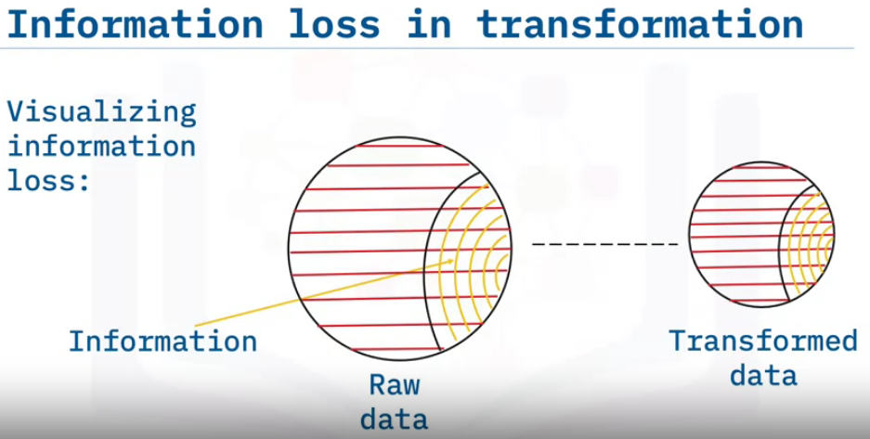
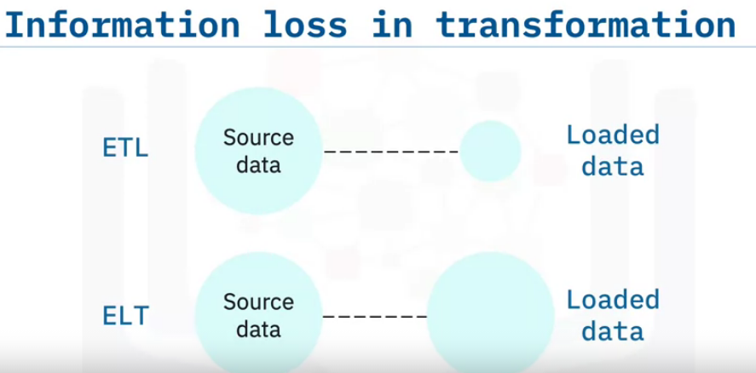
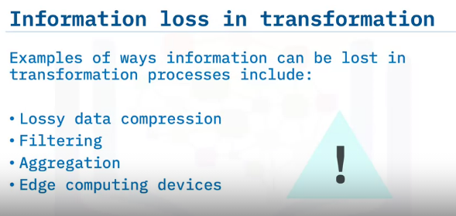


Whether intentional or accidental, there are many ways in which information can be 'lost in transformation’.
We can visualize this loss as follows.
Raw data is normally much bigger than transformed data. Since data usually contains noise and redundancy, we can illustrate the 'information content' of data as a proper subset of the data.
Correspondingly, we can see that shrinking the 'data volume' can also mean shrinking the 'information content’.
Either way, for ETL processes, any lost information may or may not be recoverable, whereas with ELT, all the original information content is left intact because the data is simply copied over as-is.
Examples of ways information can be lost in transformation processes include:
Lossy data compression. For example, converting floating point values to integers, reducing bitrates on audio or video.
Filtering. For example, filtering is usually a temporary selection of a subset of data, but when it is permanent, information can easily be discarded.
Aggregation. For example, average yearly sales vs. daily or monthly average sales.
Edge computing devices. For example, false negatives in surveillance devices designed to only stream alarm signals, not the raw data.

Slide 21
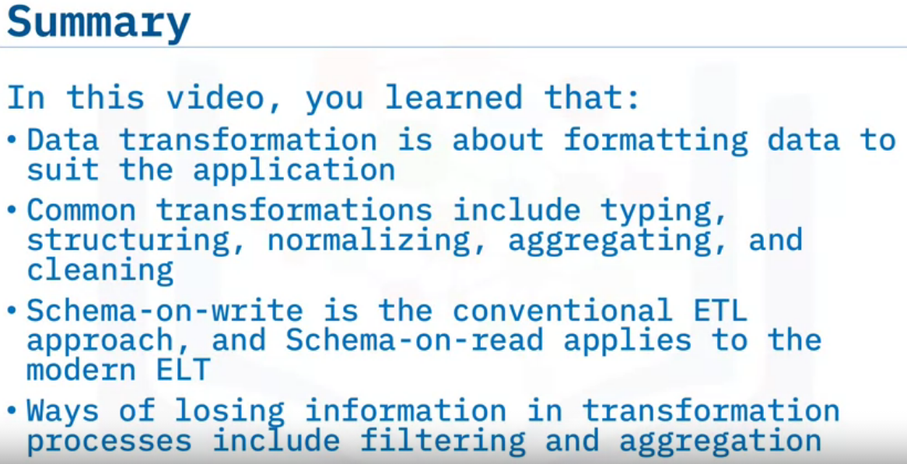

Slide 22
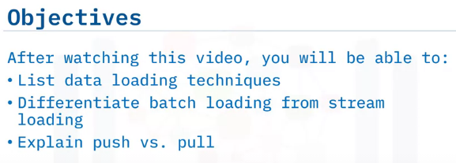
Data Loading Techniques

Slide 23
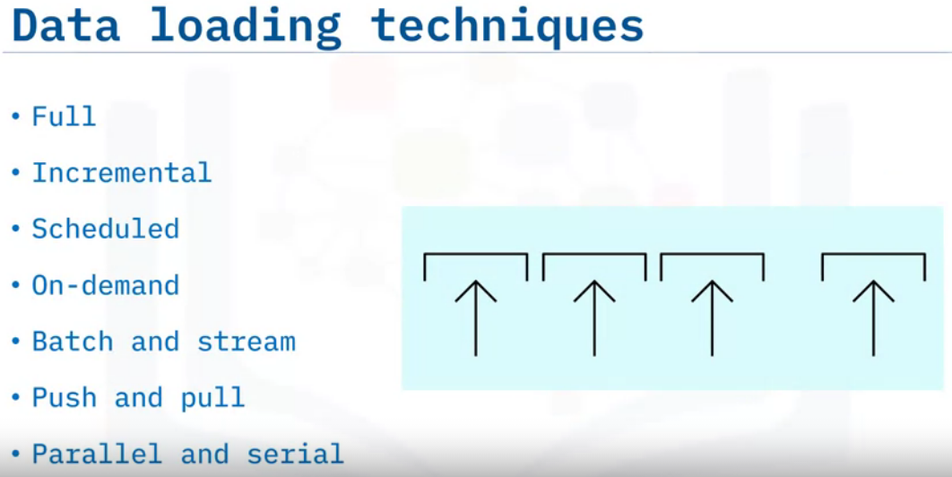
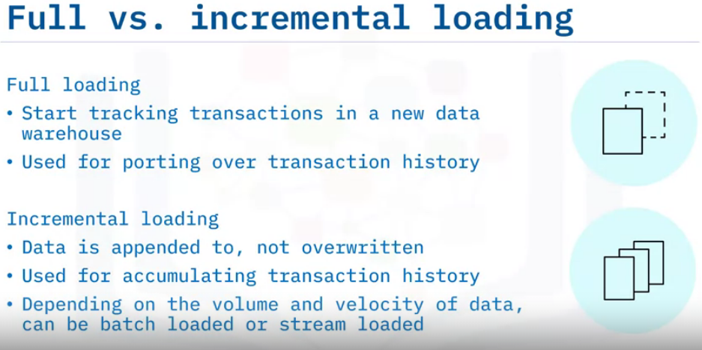
There are many techniques for loading data, some of which are:
“Full loading”: You can load an initial history into a database, after which
“incremental loading” is applied to insert new data or to update already loaded data.
You can schedule data loading to occur on a periodic basis,
or you can load it as required, on demand.
Data can be loaded in batches, or it can be streaming continuously to its destination.
The data can be either pushed to a server or pushed to clients by a server.
Data is usually loaded serially, but it can also be loaded in parallel.
Full loading refers to loading data in one large batch.
This is used, for example, when organizations want to start tracking transactions in a new data warehouse and they copy the existing transaction history from the old to the new system.
Then it's a matter of incrementally loading transactions as they arise, thus ensuring the transaction history is tracked.
With incremental loading, the target data store is appended to, such that only the changes are loaded.
This is useful for accumulating historical data such as transactions, weather, and browsing history.
The volume, velocity, and demand for the data determine whether the data is loaded in batches or streamed live

Slide 24
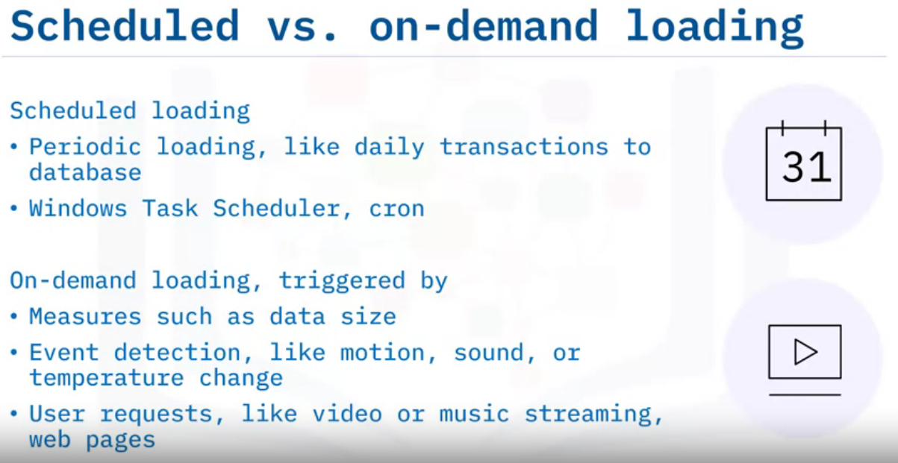
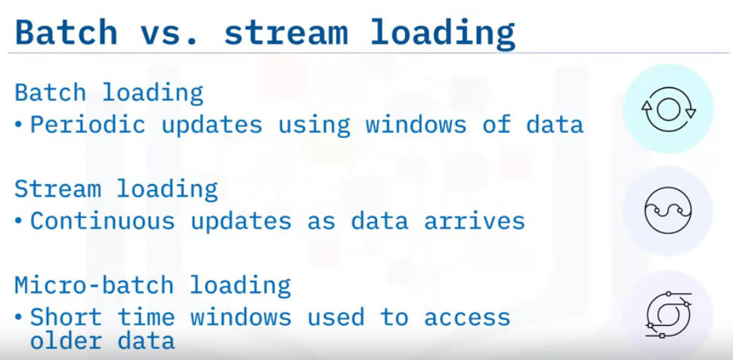
Data is often loaded on a schedule. For example: Daily point-of-sale transactions can be loaded into a database at the end of each day, during off-peak hours.
Loading tasks can be scheduled with tools such as Windows Task Scheduler, or with cron on Unix-like systems.
On-demand loading is also very common, and relies on triggering mechanisms such as:
when the source data reaches a specified size.
when an event is detected by the source system, such as motion, sounds or temperature changes,
when a user requests data, such as online videos, music, or web pages.
Batch and stream data loading are two ends of a spectrum of loading methods.
Batch loading refers to loading data in chunks defined by some time windows of data accumulated by the data source, usually on the order of hours to days.
stream loading, which loads data in real time as it becomes available.
In between batch and stream loading, we have micro-batch loading. This is used when imminent processes need access to a small window of recent data.

Slide 25
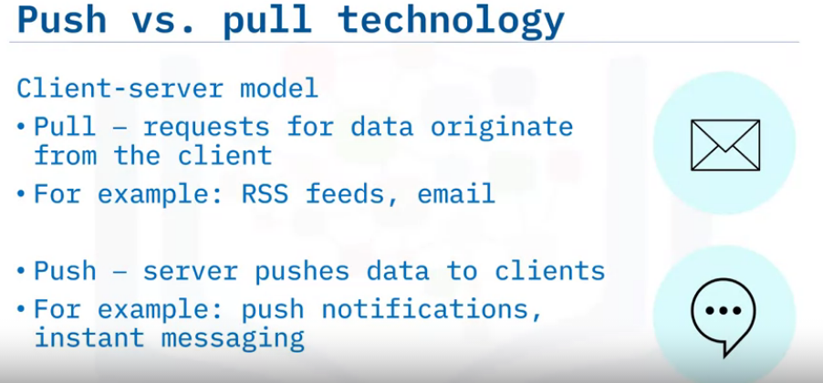
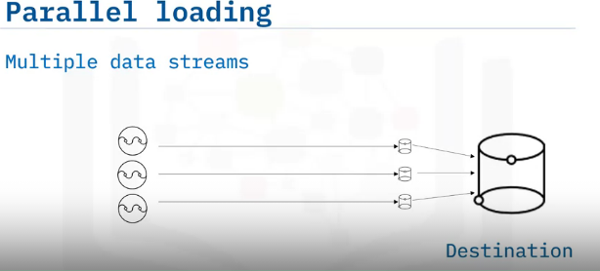
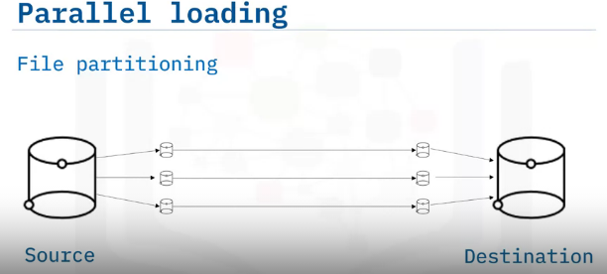
Push and pull data-loading methods are based on a client-server model.
A “pull” refers to a client initiating a request for data from a server.
The server then responds to the client’s request and delivers the data.
Ex. RSS feeds and email.
With “push” technology, the client subscribes to a service provided by a server, so that the server can then push data to the client as it becomes available.
Ex. push notifications and instant messaging services.
Parallel loading can be employed on multiple data streams to boost loading efficiency, particularly when the data is big or has to travel long distances.
Similarly, by splitting a single file into smaller chunks, the chunks can be loaded simultaneously.

Slide 26
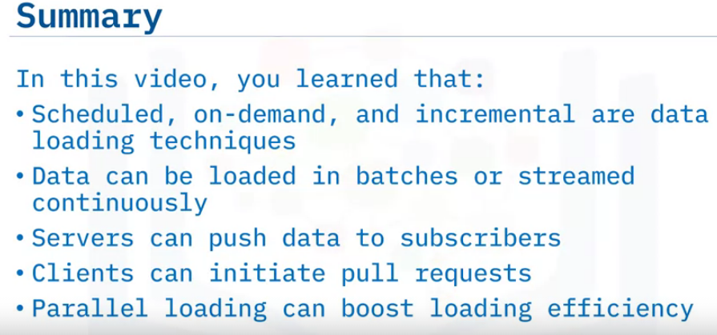

Slide 27
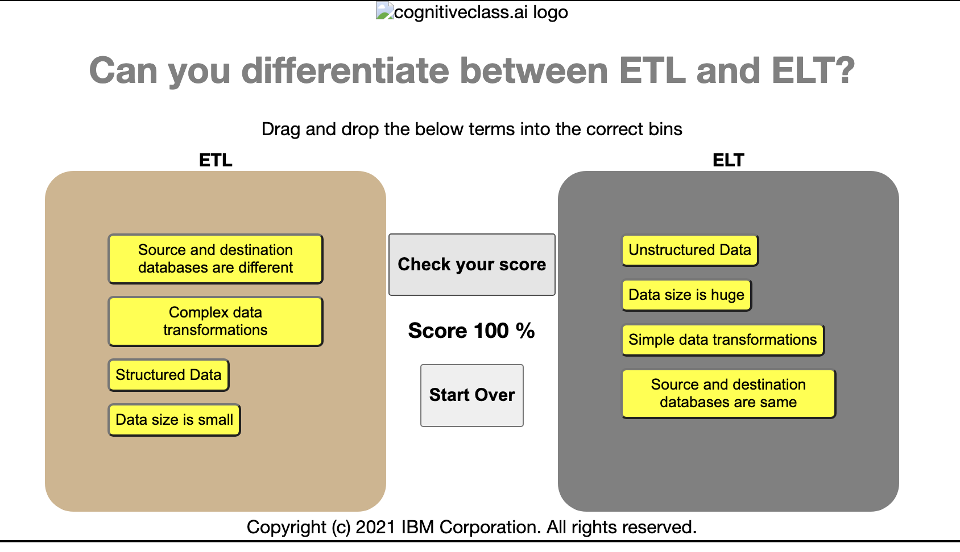
Data Warehouse
Data Lake

Slide 28
Aspect | Data Lake | Data Warehouse
Data Structure | Raw, unprocessed, varied (structured, semi-structured, unstructured) | Structured, predefined schema
Data Processing | Processing at the time of analysis | Predefined transformations during ETL
Schema Flexibility | Schema-on-read | Predefined schema and structure
Data Integration | Wide range of data types and sources | Primarily structured data integration
Use Cases | Flexible analysis, exploratory analytics, machine learning | Reporting, querying, business intelligence
Storage Approach | Flat architecture | Relational database system

Slide 29
Summary & Highlights
Congratulations! You have completed this module. At this point, you know:
ETL stands for Extract, Transform, and Load
Loading means writing the data to its destination environment
Cloud platforms are enabling ELT to become an emerging trend
The key differences between ETL and ELT include the place of transformation, flexibility, Big Data support, and time-to-insight
There is an increasing demand for access to raw data that drives the evolution from ETL, which is still used, to ELT, which enables ad-hoc, self-serve analytics
Data extraction often involves advanced technology including database querying, web scraping, and APIs
Data transformation, such as typing, structuring, normalizing, aggregating, and cleaning, is about formatting data to suit the application
Information can be lost in transformation processes through filtering and aggregation
Data loading techniques include scheduled, on-demand, and incremental
Data can be loaded in batches or streamed continuously

